Slide 1
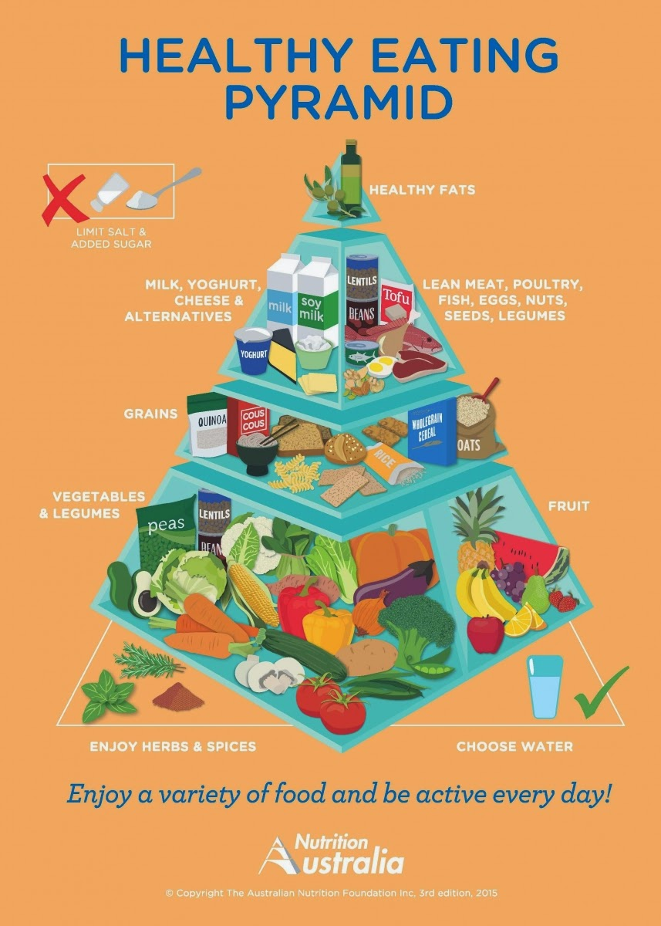
Breaking the fast
LI: Understand the importance of eating a healthy breakfast.
Design a healthy breakfast that a teenager could eat .
SC: Research why breakfast is important and which foods would be popular amongst teens.
Produce a breakfast that conforms to the healthy eating pyramid.

Slide 2
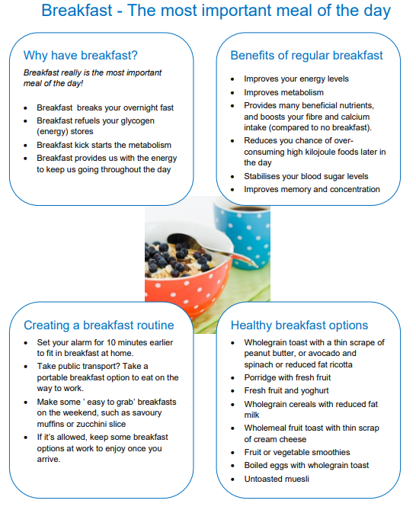
ICT Research
Why is breakfast important and beneficial to your day?
Go to https://nutritionaustralia.org/fact-sheets/breakfast/ and answer questions 1-4.
Go to https://nutritionaustralia.org/fact-sheets/healthy-eating-pyramid/ and answer questions 5-6.
LI: Understand the importance of eating a healthy breakfast.
Design a healthy breakfast that a teenager could eat .
SC: Research why breakfast is important and which foods would be popular amongst teens.
Produce a breakfast that conforms to the healthy eating pyramid.

Slide 3
Healthy Breakfast…
THINK PAIR SHARE: What are three things you can do to create a healthy, well balanced and easy to prepare breakfast?
LI: Understand the importance of eating a healthy breakfast.
Design a healthy breakfast that a teenager could eat .
SC: Research why breakfast is important and which foods would be popular amongst teens.
Produce a breakfast that conforms to the healthy eating pyramid.

Slide 4
CONSTRAINTS
What are constraints?
A constraint is something that limits or controls what you can do.
What are some examples of constraints?
Time – will I have enough time in the session to complete my breakfast?
Cost – does it meet a reasonable budget that I could recreate on a daily basis
Benefits –Does my breakfast meet the needs of the pyramid?
Quality- Do I have the skills to make a quality meal that appeals to teenagers?
Risks – Are there any risks that will affect me successfully producing my breakfast?
LI: Understand the importance of eating a healthy breakfast.
Design a healthy breakfast that a teenager could eat .
SC: Research why breakfast is important and which foods would be popular amongst teens.
Produce a breakfast that conforms to the healthy eating pyramid.

Slide 5

SURVEY TIME!
Find 4 students outside your table group and conduct a survey of their breakfast habits.
If they don’t eat breakfast ask them what they would eat if they did and where they would that would help them to eat breakfast more often.
DO NOT write ‘nothing’ and ‘no one’!!
When finished write three sentences to summarise the reasons for eating and not eating breakfast.
LI: Understand the importance of eating a healthy breakfast.
Design a healthy breakfast that a teenager could eat .
SC: Research why breakfast is important and which foods would be popular amongst teens.
Produce a breakfast that conforms to the healthy eating pyramid.

Slide 6
VALUES
What is a value?
A value is the regard that something is held to deserve; the importance, worth, or usefulness of something.
Split into two groups –
Left of the room = eat breakfast
Right = don’t eat breakfast.
If you eat breakfast, what is some of the things you value?
If you don’t eat breakfast, what is some of the things you value?
LI: Understand the importance of eating a healthy breakfast.
Design a healthy breakfast that a teenager could eat .
SC: Research why breakfast is important and which foods would be popular amongst teens.
Produce a breakfast that conforms to the healthy eating pyramid.

Slide 7
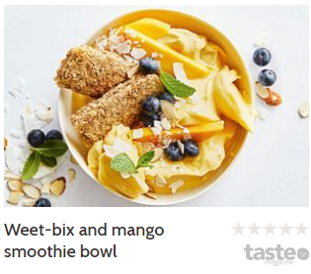
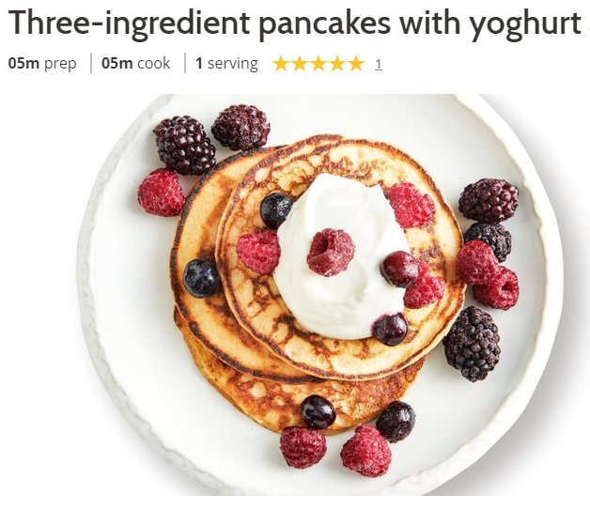

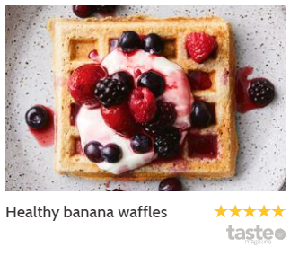
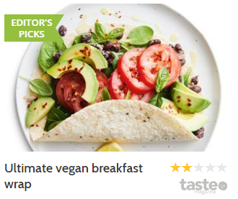

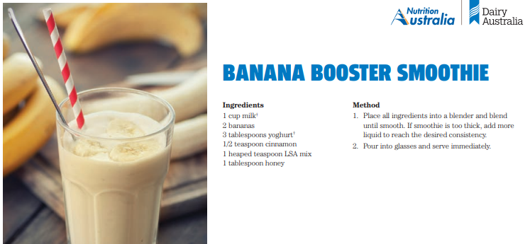
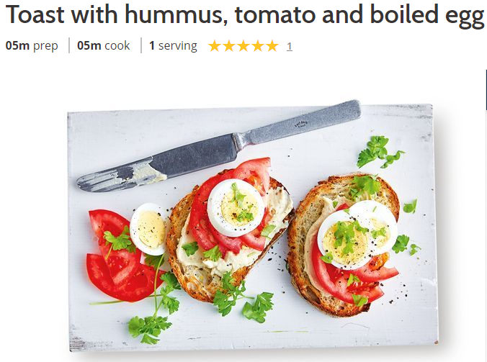
DEVISING
BRAINSTORM a minimum of 10 options: What could I make for breakfast?
LI: Understand the importance of eating a healthy breakfast.
Design a healthy breakfast that a teenager could eat .
SC: Research why breakfast is important and which foods would be popular amongst teens.
Produce a breakfast that conforms to the healthy eating pyramid.

Slide 8
YOUR BREAKFAST…
Choose one idea from your brainstorm and devise in detail
List ingredients
Draw and label
Place ingredients in the pyramid
Is it healthy – why/why not?
LI: Understand the importance of eating a healthy breakfast.
Design a healthy breakfast that a teenager could eat .
SC: Research why breakfast is important and which foods would be popular amongst teens.
Produce a breakfast that conforms to the healthy eating pyramid.

Slide 9
YOUR BREAKFAST…
What ingredients and equipment will you require?
Remember that what you place in your food order is what you get! So double check all your ingredients are correct!
LI: Understand the importance of eating a healthy breakfast.
Design a healthy breakfast that a teenager could eat .
SC: Research why breakfast is important and which foods would be popular amongst teens.
Produce a breakfast that conforms to the healthy eating pyramid.

Slide 10
TIME PLAN…
When cooking, it is important that your time plan is thorough and correct. This means that I should be able to cook it without your help or knowing what the recipe is!! Your start time is: 8FST_4:10:00am 8FST_5: 2:00pm
Eg.
10:02am: Put on Apron, tie back hair and wash hands.
10:05am: gather equipment needed.
10:07am: collect ingredients.
10:09am: preheat pan.
10:10am: chop up vegetables and transfer to pan.
10:12am: slice up ham and add to pan.
10:13am: crack egg into jug and add milk. Mix with a fork until well combined.
10:14am: pour into pan and cover with lid.
10:16am: flip omelette and cover with lid.
10:17am: plug in toaster and add a slice. Push button down to begin cooking.
10:18am: turn pan off.
10:19am: butter toast and plate up omelette. Cover.
10:22am: wash and dry dishes, clean area and have teacher inspect dishes before putting away. Show teacher food to take a photo.
10:26am: eat.
10:36am: wash remaining dishes and complete duties.
LI: Understand the importance of eating a healthy breakfast.
Design a healthy breakfast that a teenager could eat .
SC: Research why breakfast is important and which foods would be popular amongst teens.
Produce a breakfast that conforms to the healthy eating pyramid.

